Slide 1

Webinar Today: ePNRetail
Point-Of-Sale
Problems? Please email kbrown@eprocessingnetwork.com

Slide 2
What is it?
Solution designed for smaller merchants wanting more than a cc terminal
These merchants can’t afford thousands of dollars for a Point-Of-Sale system
Supports: PIN debit, checks, inventory, signature capture, etc
Does not include: restaurant tip, time & attendance, or payroll applications
Requires: merchant-owned, Windows-based computer or laptop; internet connection

Slide 3
Who’s it for?
Smaller retail merchants with only one location
Level 4 merchants: process up to $40,000 annually in Visa/MC volume
Level 3 merchants: process between $40,000 and $1 million annually in Visa/MC volume
Hardware stores, automotive parts, lawn & garden supply, grocers & bakeries, clothing boutiques, shoe stores, home furnishings, flooring stores, electronics stores, museum stores, florists…

Slide 4
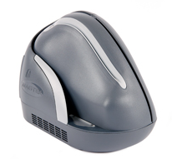
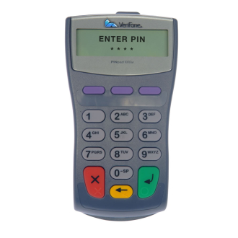
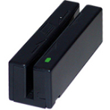
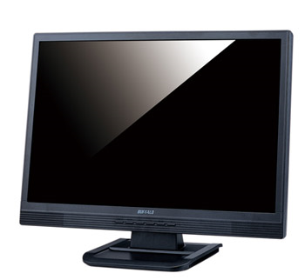
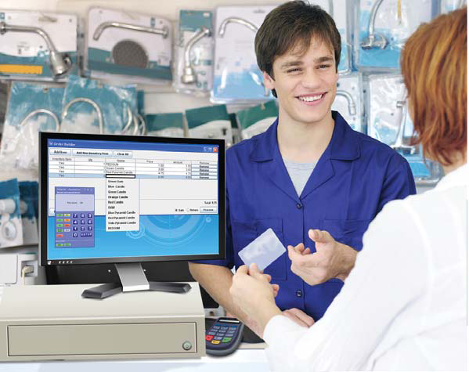
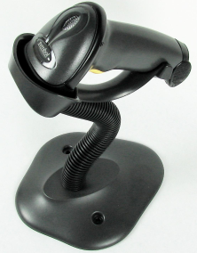

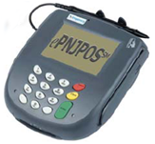
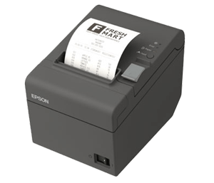
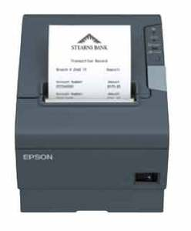
Introducing…. ePNRetail POS
Credit – Debit/PIN – Checks - Gift/Loyalty – Inventory – Cash Drawer – Barcode Scanner –
Receipt Printer
Verifone PINPad 1000se
Magtek Excella MDX
MagTek USB Card Reader
ID Tech VersaScan Barcode Scanner
M-S Cash Drawer N-CR6210B
Ingenico i6550 PINPad and
Signature Capture Device
EPSON TM-T88V
EPSON TM-T20

Slide 5

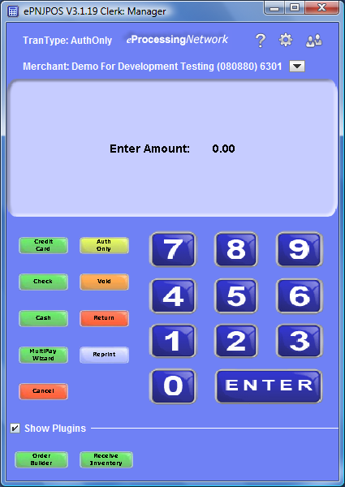
Replace traditional terminal
Use merchant’s own Windows® computer/laptops
Internet Processing
Manager Controls
  Prevent internet surfing
  Track sales by clerk ID
  Block Refunds and Voids
Receipts
  Any Windows-compatible printer
  Customizable Receipts
  eMail receipts
ePNInventory
  Order Builder
  Receive Inventory
Transaction Types
  Swiped or Keyed Credit Card
  PIN Debit
  Refunds, Voids, Auth Only
  Cash
  Checks
  Gift Card and Loyalty
  Purchase Card Level 2
  Signature Capture
PA-DSS Certified!

Slide 6
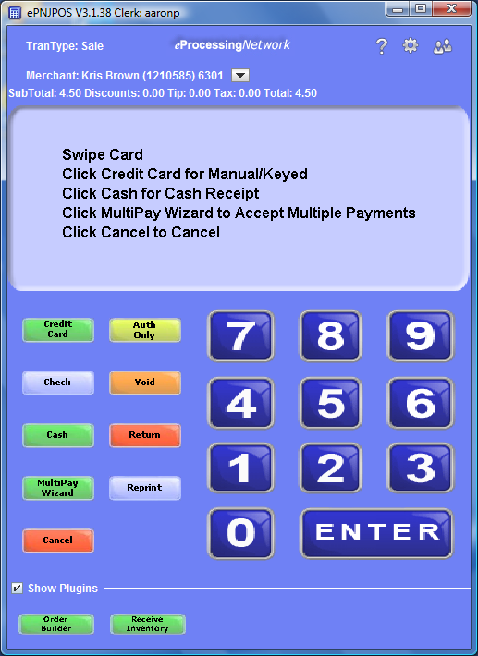
ePNJPOS w/ ePNInventory
Receive Inventory
  Record when product is received
Order Builder
  Record product(s) customer is purchasing
  Automatically populates amount in JPOS
Both support barcode scanners from Symbol and HP

Slide 7
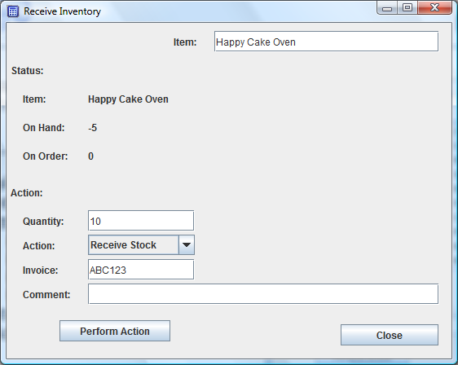
Receive Inventory
Use to record product delivered to merchant’s store or warehouse
Select product/item received
Enter quantity received
Actions
  Receive Stock
  Account For Shrinkage
  Add to Stock
  Add A Note
4. Enter Invoice Number
5. Add a comment

Slide 8
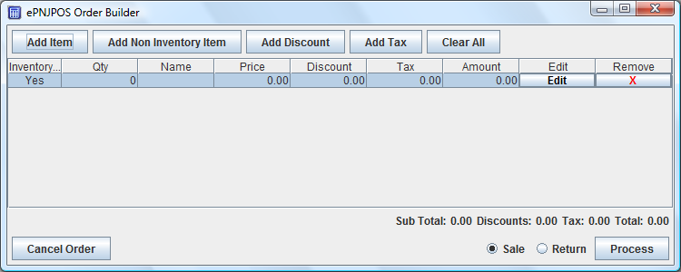
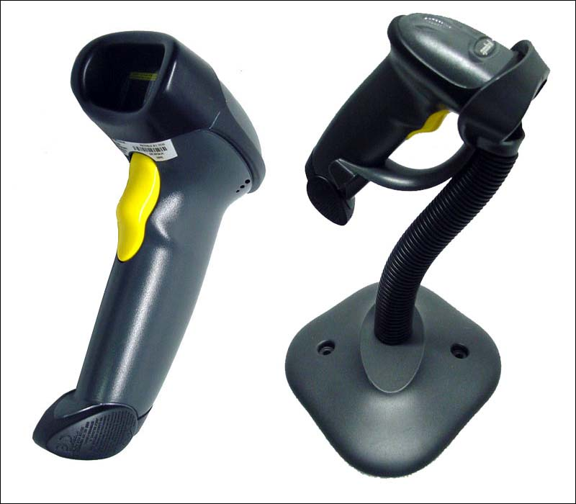
Order Builder in ePNJPOS
Add Item: Select product from ePNInventory database
Add Non Inventory Item: Add product not in ePNInventory database
Add Discount & Add Tax: Allows for additional discount and tax to be included with this order “on the fly”

Slide 9
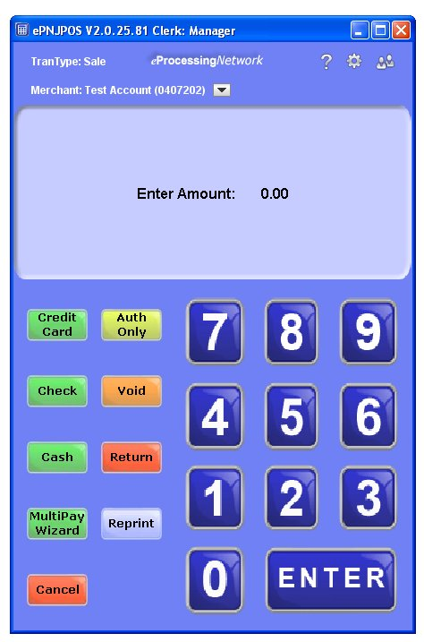
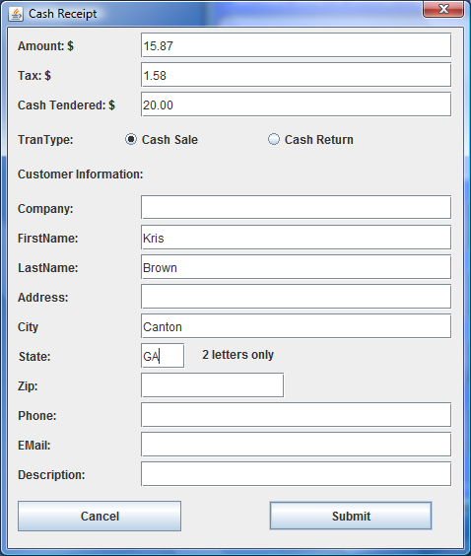
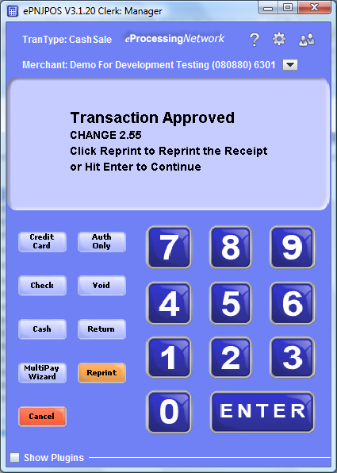
ePNJPOS w/ Cash Transactions

Slide 10
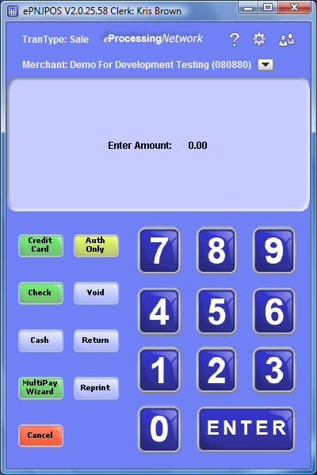
ePNJPOS w/ Ingenico i6550
Customer Initiated Swipe
PIN Debit*
Signature Capture
Card Present Rate
User Friendly Touch Screen
Most transactions processed through this line of terminals Worldwide

Slide 11

Benefits of Signature Capture
Reduced Labor Costs
  On average, one minute of handling is required during the lifetime of each ticket and each ticket is handled 9 times
Eliminated Storage Costs
  Eliminate: Paper Rolls, Envelopes, Boxes, Storage Facility
Decreased Chargeback Losses
  Eliminate lost receipts
  Decrease “no signatures” by up to 70%
  Stop chargeback write offs

Slide 12
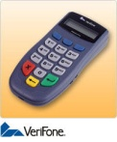

ePNJPOS w/ Verifone 1000se
Affordable PIN Debit* solution
Card swipe with Magtek reader
Card Present Rate
*Note: PIN Debit not available on FDC-Nashville and Jetpay.

Slide 13
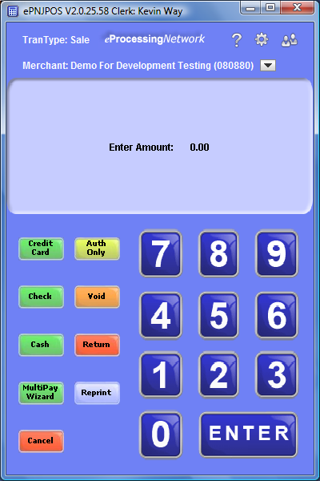
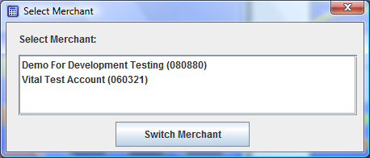
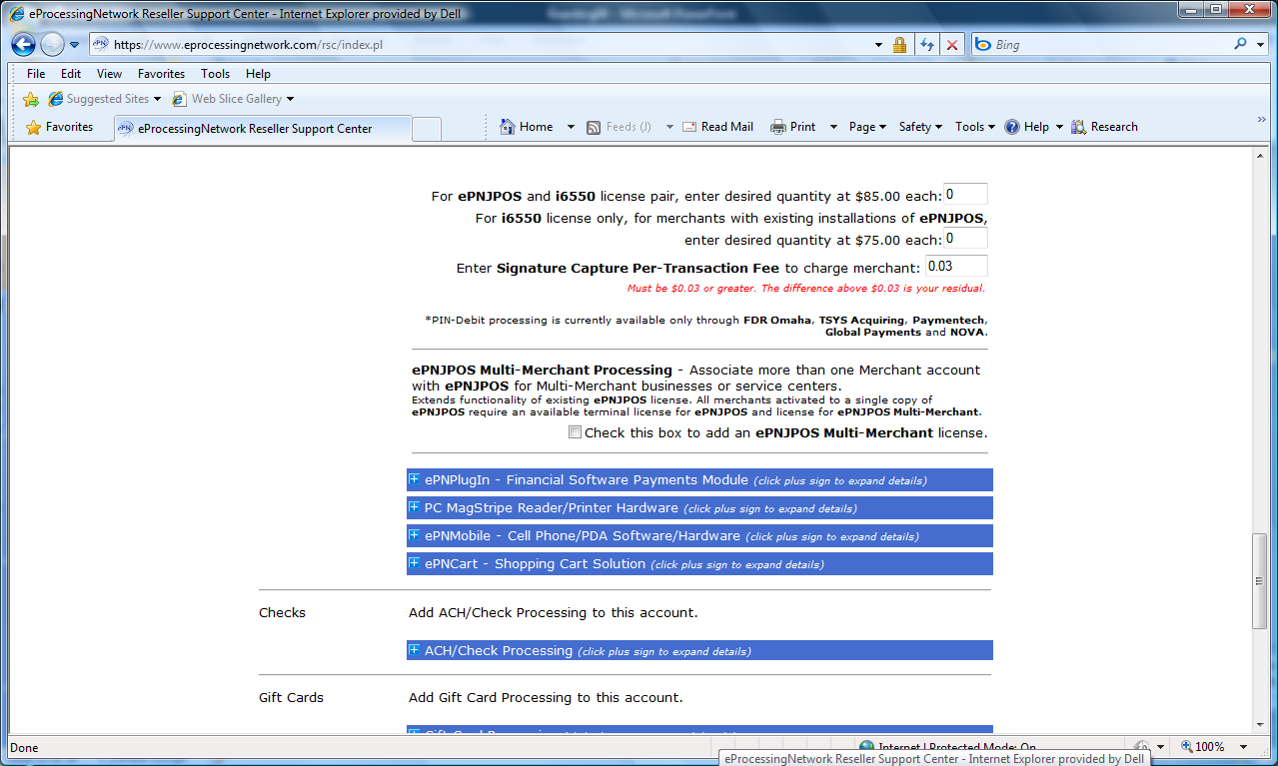
Multi Merchant
  Unlimited number of ePN gateway accounts on one ePNJPOS download
  Account can be either Online Terminal Only, Internet Basic, or a mix
  Toggle between accounts during the day for easy administration and checkout
NOTE: When boarding the merchant, be sure to enable multi merchant capability here:

Slide 14
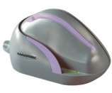
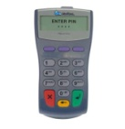
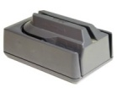


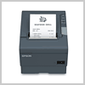
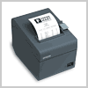
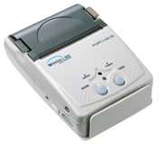
Supported Peripherals
Card Readers & PIN Pads
Cash Drawer
Check Readers & Imagers
MagTek USB Card Reader
M-S Cash Drawer N-CR6210B
MagTek MICR Imager
Verifone 1000SE PIN Pad
MagTek Mini MICR Imager
Receipt Printers
Ingenico i6550 - PIN Debit + Card Swipe + Sig Capture
MagTek Excella MDX
Epson TM-T88V
Bar Code Scanners
Bluetooth Device
Symbol & HP LS 2208
ID TECH IDBB-4241LRB with Stand IDBB-4001LRBS
Woosim PORTI-SC30 Card Reader & Printer
Epson ReadyPrint T20

Slide 15
Here’s How You Set It Up
1. Acquire Merchant Account
2. Board Merchant on ePN:
Online Terminal Only account OR Internet Basic Account
3. Purchase ePNJPOS software license and hardware required. (Note additional license fees for PIN debit, ePNInventory, and Check 21.)
4. Merchant downloads ePNJPOS from the ePN Merchant Support Center

Slide 16
Merchant Notification Email
Dear Merchant, This email is to notify you that your account with eProcessing Network has been activated with ePNJPOS, This is a sofware that will allow you to process Mastercard and Visa transactions from your desktop of your PC or Laptop without a login;
Installation instructions are below.
Installing ePNJPOS
First you need to check your JAVA, in a web browser goto: http://www.eprocessingnetwork.com/isjavaok/index.html
this should say Congratulations!! Your Java is capable of running ePNJPOS and tell you your version of Java. If you do not it will tell you that Java is not installed. On your PC download JAVA on the computer that you want to install ePNJPOS. With your internet browser go to http://www.java.com/en/ and download the latest version of JAVA to the computer. Once you have installed JAVA restart your computer before installing ePNJPOS.
-------------------------------------------------------------
View the Online Documentation with Installation Instructions: http://www.eprocessingnetwork.com/ePNJPOS2/help.html
Thank you,
eProcessingNetwork
Support@eProcessingNetwork.com
800-971-0997

Slide 17
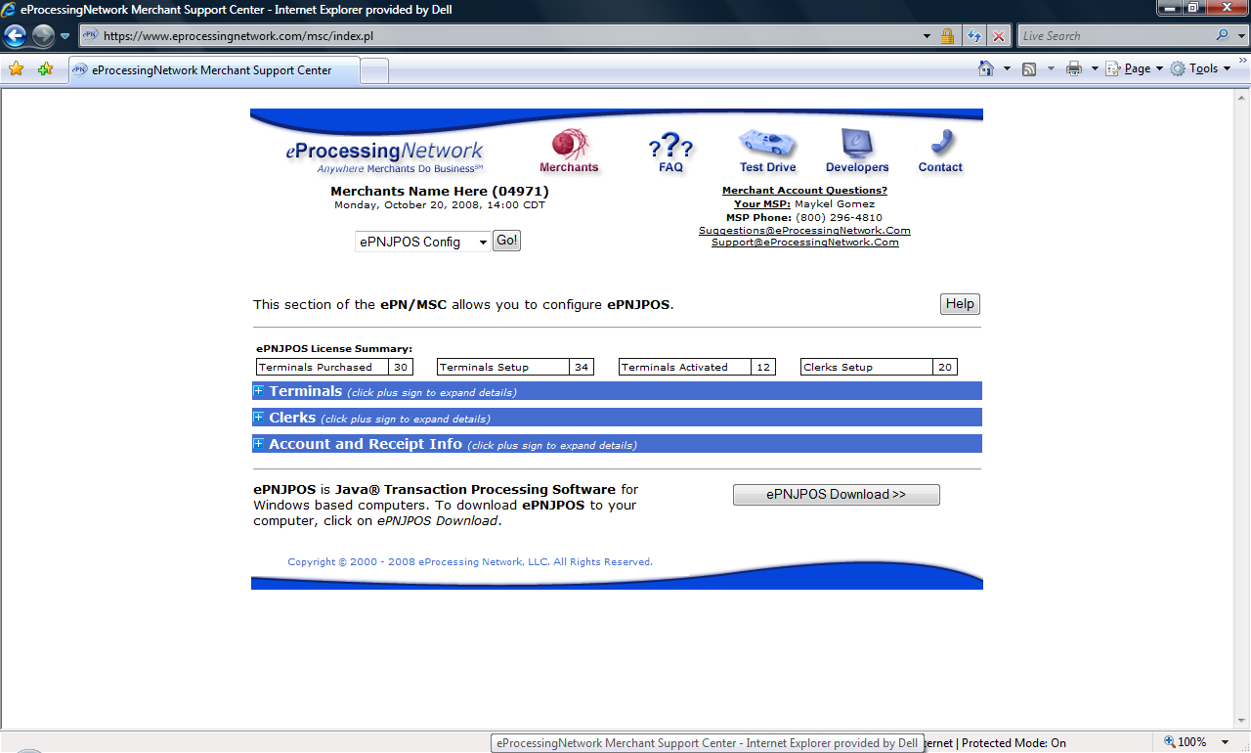
Installation is Easy!
Call merchant with Username & Password
Merchant logs into Merchant Support Center
From dropdown menu, select ePNJPOS Config, then select the ePNJPOS Download>> button

Slide 18
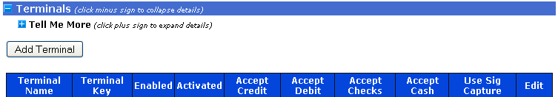
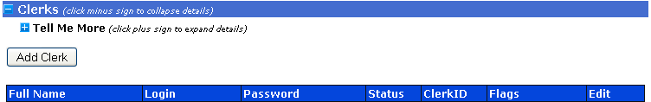
ePNJPOS Config. Options
One terminal per purchased license
Unlimited clerks per terminal
Assign roles to clerks (managers etc.)
Edit, Add & Delete clerks and/or roles

Slide 19
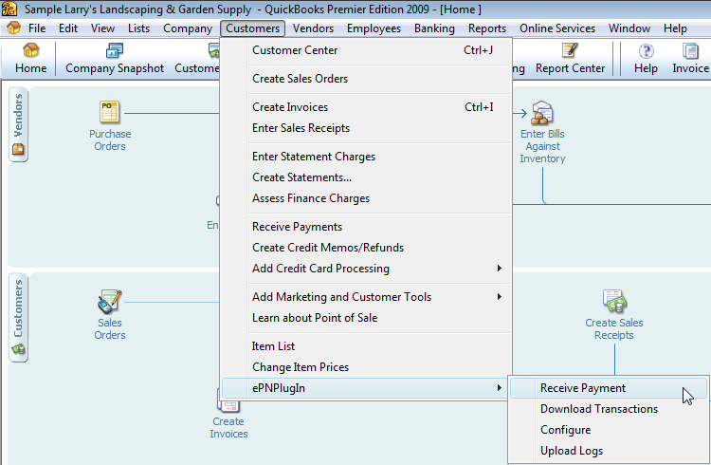
Download Transactions From ePNJPOS into QuickBooks with ePNPlugIn!
ePN Gateway

Slide 20
Merchant Benefits
“Ala Carte” Hardware Solution
  Only buy hardware components merchant requires
  Use merchant’s own computer/laptop
ePNJPOS Software
  Replace stand alone terminal
ePNInventory
  Combine product sales with payment application
  Reduce clerical work and double entry
Multiple Payment Types
Managerial Controls
  No browser required
  Control access to Refunds and Voids
Process multiple checkout lanes through one gateway account
  One batch to close at the end of the day
Electronically download transactions into QuickBooks
  Save 2 hours, on average, per week

Slide 21


Questions
kbrown@eprocessingnetwork.com
800-296-4810 x.152#

